Slide 1
Chapter 6: Database Design Using the E-R Model

Slide 2
ER-Model
ER-Model: Entity-Relationship Model
Entity sets:
Rectangles represent entity sets
Attributes are listed inside entity rectangle
Underline indicates primary key attributes
Relationship sets:
Association among entities
Diamonds represent relationship sets

Slide 3
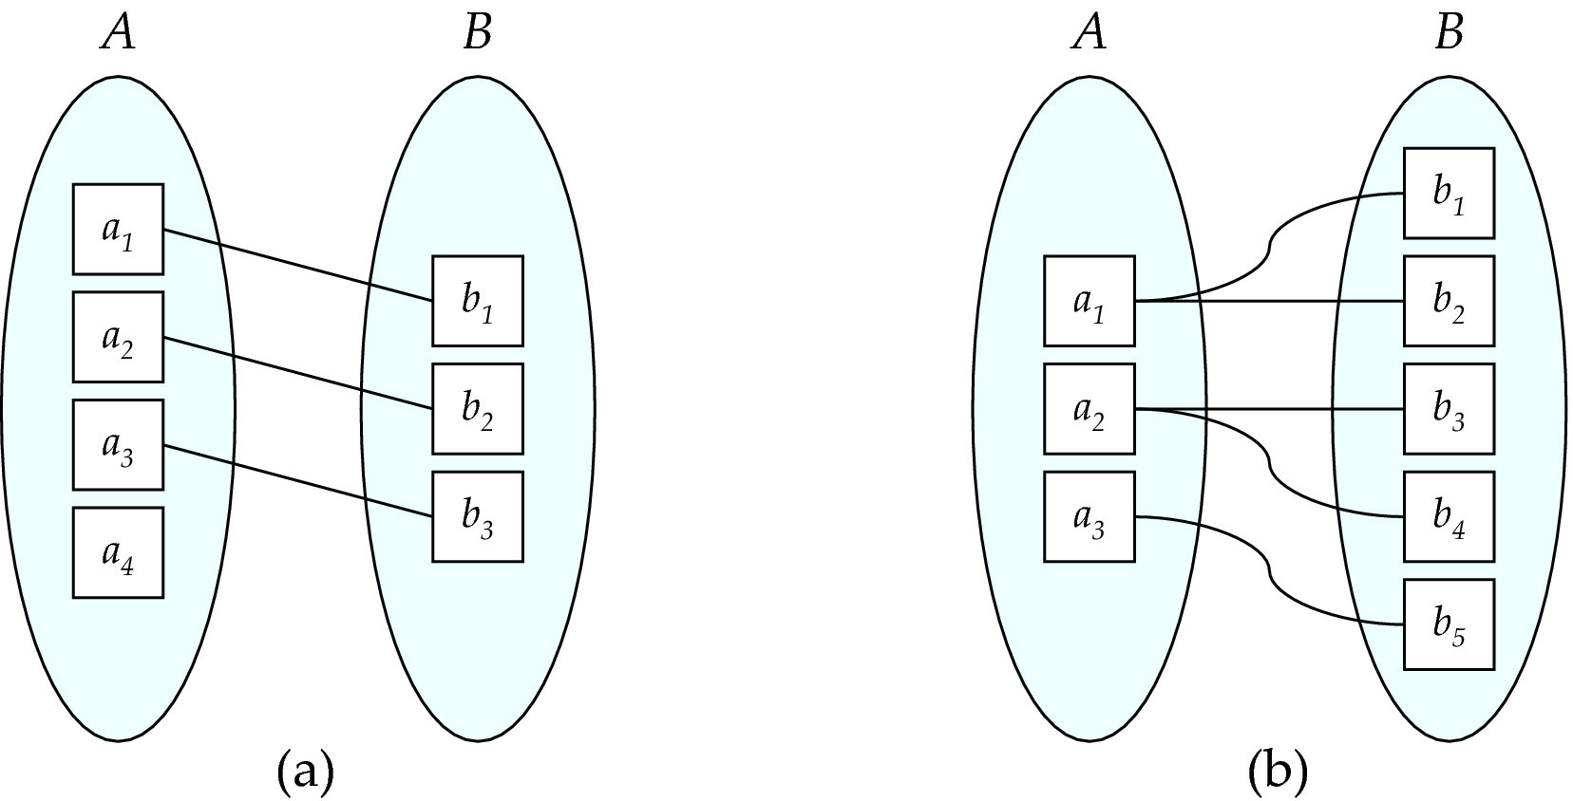
Mapping Cardinalities
One to one
One to many
Note: Some elements in A and B may not be mapped to any
elements in the other set

Slide 4
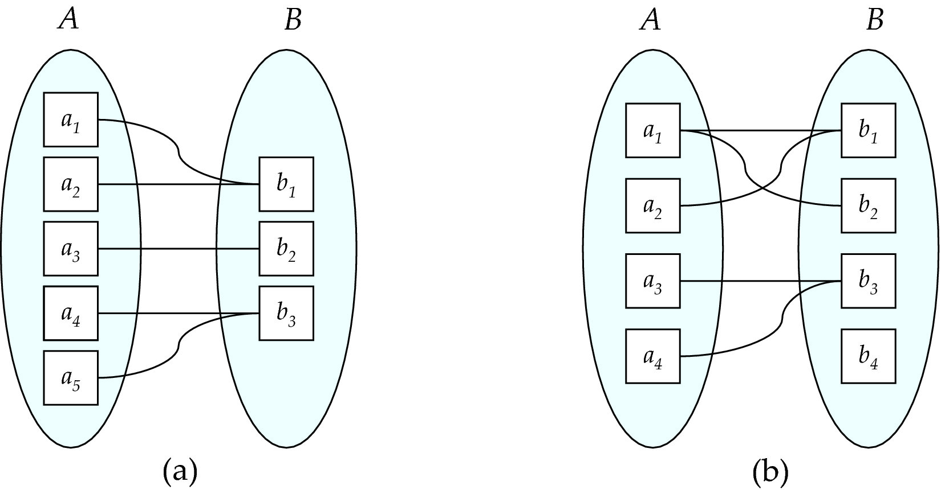
Mapping Cardinalities
Many to one
Many to many
Note: Some elements in A and B may not be mapped to any
elements in the other set

Slide 5


Representing Cardinality Constraints in ER Diagram
We express cardinality constraints by drawing the following between the relationship set and the entity set:
A directed line (→): signifying “one”
An undirected line (—): signifying “many”
One-to-one relationship:
A student is associated with at most one instructor via the relationship advisor
An instructor is associated with at most one student via the relationship advisor

Slide 6
Representing Cardinality Constraints in ER Diagram
We express cardinality constraints by drawing the following between the relationship set and the entity set:
A directed line (→): signifying “one”
An undirected line (—): signifying “many”
One-to-many relationship:
A student is associated with at most one instructor via the relationship advisor
An instructor is associated with several (including 0) students via the relationship advisor

Slide 7
Representing Cardinality Constraints in ER Diagram
We express cardinality constraints by drawing the following between the relationship set and the entity set:
A directed line (→): signifying “one”
An undirected line (—): signifying “many”
Many-to-one relationship:
A student is associated with several (including 0) instructor via the relationship advisor
An instructor is associated with at most one student via the relationship advisor

Slide 8


Representing Cardinality Constraints in ER Diagram
We express cardinality constraints by drawing the following between the relationship set and the entity set:
A directed line (→): signifying “one”
An undirected line (—): signifying “many”
Many-to-many relationship:
A student is associated with several (including 0) instructor via the relationship advisor
An instructor is associated with several (including 0) students via the relationship advisor

Slide 9

Total Participation
Total participation: double line
Every entity in the entity set participates in at least one relationship in the relationship
Every student must have at least one associated instructor
i.e., Participation of student in advisor relation is total
Partial
Participation
Total
Participation

Slide 10
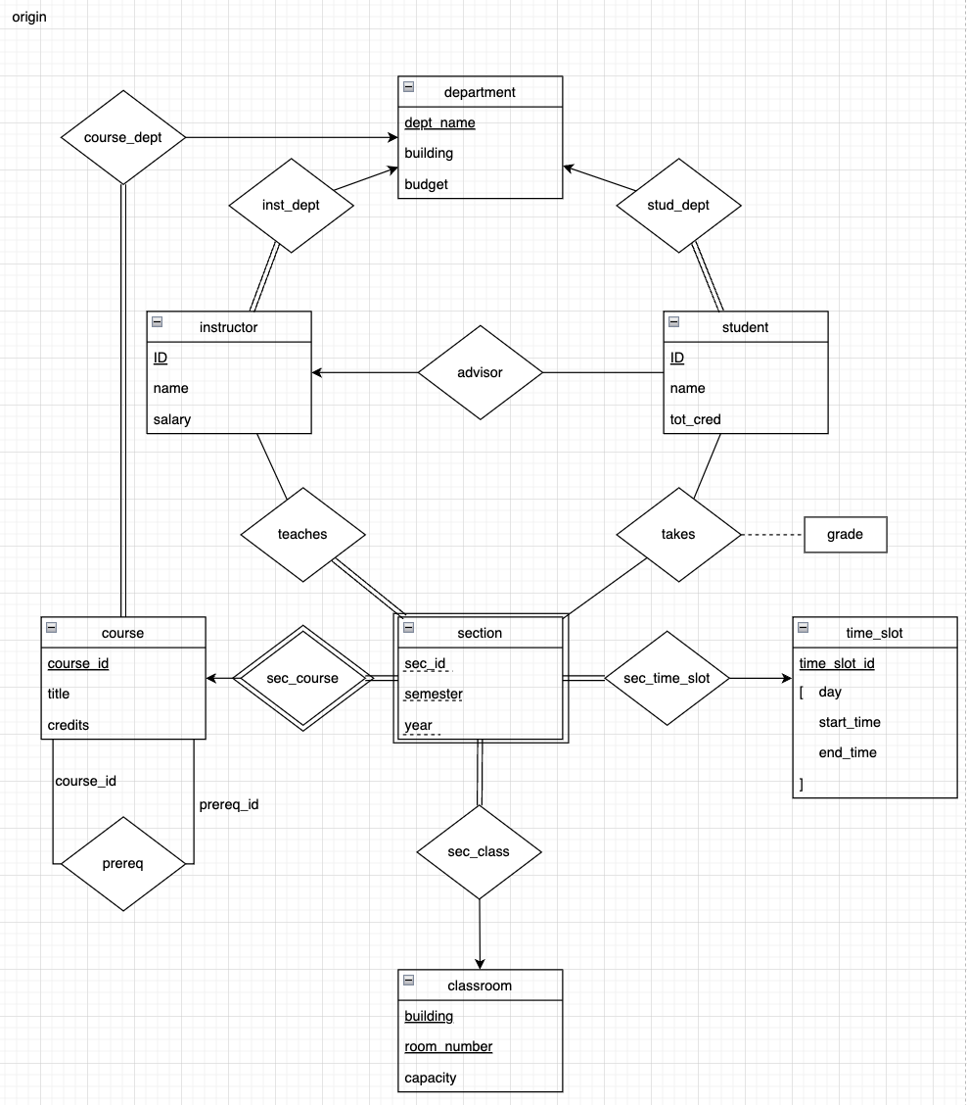
Exercise 1
Please modify the ER diagram of by enforcing the following requirements:
a) Each instructor can work for multiple departments.
b) Each section can only have one instructor to teach.
c) Each instructor can only have at most one student to advise, and each student can only have at most one instructor as his adviser.
d) Each course can only have at most one prerequisite course.

Slide 11
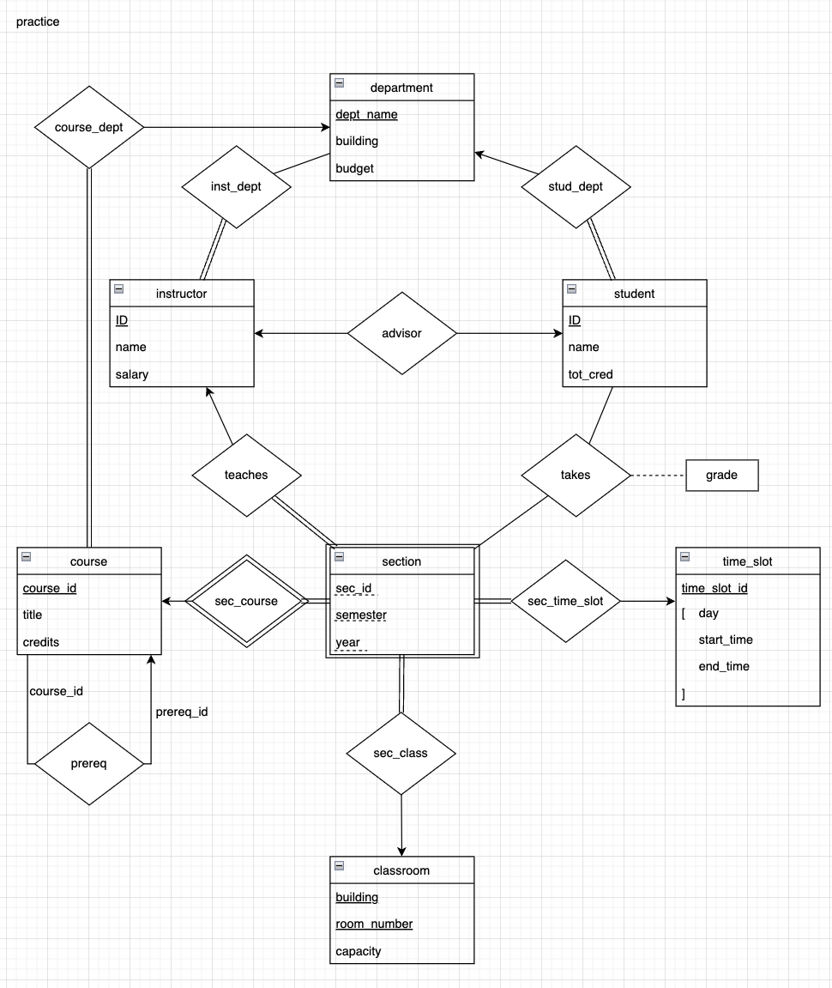

Exercise 1
Please modify the ER diagram of by enforcing the following requirements:
a) Each instructor can work for multiple departments.
b) Each section can only have one instructor to teach.
c) Each instructor can only have at most one student to advise, and each student can only have at most one instructor as his adviser.
d) Each course can only have at most one prerequisite course.

Slide 12


Exercise 1
Please modify the ER diagram of by enforcing the following requirements:
a) Each instructor can work for multiple departments.
b) Each section can only have one instructor to teach.
c) Each instructor can only have at most one student to advise, and each student can only have at most one instructor as his adviser.
d) Each course can only have at most one prerequisite course.
Taught by at most
one instructor
Taught by at least
one instructor

Slide 13


Exercise 1
Please modify the ER diagram of by enforcing the following requirements:
a) Each instructor can work for multiple departments.
b) Each section can only have one instructor to teach.
c) Each instructor can only have at most one student to advise, and each student can only have at most one instructor as his adviser.
d) Each course can only have at most one prerequisite course.

Slide 14

Exercise 1
Please modify the ER diagram of by enforcing the following requirements:
a) Each instructor can work for multiple departments.
b) Each section can only have one instructor to teach.
c) Each instructor can only have at most one student to advise, and each student can only have at most one instructor as his adviser.
d) Each course can only have at most one prerequisite course.

Slide 15
Exercise 2
Give an ER diagram for a database recording information about teams, players, and their fans.
Each team has an ID, a name, a city and a color.
Each player has an ID, a name, a position and a skill level.
Each fan has an ID, a name and an age.
Each player plays for one and only one team.
Each player is coached by at most one other player.
Each fan favors at least one team.
Each fan can favor no player or many players.

Slide 16
Exercise 2
Give an ER diagram for a database recording information about teams, players, and their fans.
Each team has an ID, a name, a city and a color.
Each player has an ID, a name, a position and a skill level.
Each fan has an ID, a name and an age.
Each player plays for one and only one team.
Each player is coached by at most one other player.
Each fan favors at least one team.
Each fan can favor no player or many players.
Team
ID
name
city
color
play
for
Player
ID
name
position
skill_level
coached
by
favor
Fan
ID
name
age
favor

Slide 17

Exercise 2
Give an ER diagram for a database recording information about teams, players, and their fans.
Each team has an ID, a name, a city and a color.
Each player has an ID, a name, a position and a skill level.
Each fan has an ID, a name and an age.
Each player plays for one and only one team.
Each player is coached by at most one other player.
Each fan favors at least one team.
Each fan can favor no player or many players.
Team
ID
name
city
color
at most one
play
for
at least one
Player
ID
name
position
skill_level
coached
by
favor
Fan
ID
name
age
favor

Slide 18

Exercise 2
Give an ER diagram for a database recording information about teams, players, and their fans.
Each team has an ID, a name, a city and a color.
Each player has an ID, a name, a position and a skill level.
Each fan has an ID, a name and an age.
Each player plays for one and only one team.
Each player is coached by at most one other player.
Each fan favors at least one team.
Each fan can favor no player or many players.
at most one
Team
ID
name
city
color
play
for
Player
ID
name
position
skill_level
coached
by
favor
Fan
ID
name
age
favor

Slide 19
Exercise 2
Give an ER diagram for a database recording information about teams, players, and their fans.
Each team has an ID, a name, a city and a color.
Each player has an ID, a name, a position and a skill level.
Each fan has an ID, a name and an age.
Each player plays for one and only one team.
Each player is coached by at most one other player.
Each fan favors at least one team.
Each fan can favor no player or many players.
Team
ID
name
city
color
play
for
Player
ID
name
position
skill_level
coached
by
favor
at least one
Fan
ID
name
age
favor

Slide 20

Exercise 2
Give an ER diagram for a database recording information about teams, players, and their fans.
Each team has an ID, a name, a city and a color.
Each player has an ID, a name, a position and a skill level.
Each fan has an ID, a name and an age.
Each player plays for one and only one team.
Each player is coached by at most one other player.
Each fan favors at least one team.
Each fan can favor no player or many players.
Team
ID
name
city
color
play
for
Player
ID
name
position
skill_level
coached
by
at most several
(including 0)
favor
Fan
ID
name
age
favor

Slide 21
Reduction to Relation Schemas
A database which conforms to an E-R diagram can be represented by a collection of schemas.
There are some rules on how to represent relationship sets of different cardinalities.
Many-to-many relationship set:
Represented as a schema with attributes for the primary keys of the two participating entity sets.
Instructor (ID, name, salary)
Student (ID, name, tot_cred)
Advisor (i_id, s_id)
foreign keys

Slide 22
Reduction to Relation Schemas
A database which conforms to an E-R diagram can be represented by a collection of schemas.
There are some rules on how to represent relationship sets of different cardinalities.
Many-to-one / one-to-many relationship set:
Represented by adding an extra attribute to the “many” side, containing the primary key of the “one” side.
Department (dept_name, building, budget)
Student (ID, name, tot_cred, dept_name)
foreign key

Slide 23
Reduction to Relation Schemas
A database which conforms to an E-R diagram can be represented by a collection of schemas.
There are some rules on how to represent relationship sets of different cardinalities.
One-to-one relationship set:
Represented by adding an extra attribute to either side, containing the primary key of the other side.
Instructor (ID, name, salary)
Student (ID, name, tot_cred, i_id)
Instructor (ID, name, salary, s_id)
Student (ID, name, tot_cred)
OR
foreign key
foreign key

Slide 24
Exercise 3
Convert this ER diagram to relation schemas.
Team
ID
name
city
color
play
for
Player
ID
name
position
skill_level
coached
by
favor
Fan
ID
name
age
favor

Slide 25
Exercise 3
Convert this ER diagram to relation schemas.
Team
ID
name
city
color
play
for
Player
ID
name
position
skill_level
coached
by
favor
Fan
ID
name
age
favor
Team (ID, name, city, color)
Player (ID, name, position, skill_level)
Fan (ID, name, age)

Slide 26

Exercise 3
Convert this ER diagram to relation schemas.
Team
ID
name
city
color
play
for
Player
ID
name
position
skill_level
coached
by
one
many
favor
Fan
ID
name
age
favor
Team (ID, name, city, color)
Player (ID, name, position, skill_level, T_ID)
Fan (ID, name, age)

Slide 27


Exercise 3
Convert this ER diagram to relation schemas.
Team
ID
name
city
color
Player
ID
name
position
skill_level
one
play
for
coached
by
many
favor
Fan
ID
name
age
favor
Team (ID, name, city, color)
Player (ID, name, position, skill_level, T_ID, coached_by)
Fan (ID, name, age)

Slide 28


Exercise 3
Convert this ER diagram to relation schemas.
Team
ID
name
city
color
play
for
Player
ID
name
position
skill_level
coached
by
many
favor
many
Fan
ID
name
age
favor
Team (ID, name, city, color)
Player (ID, name, position, skill_level, T_ID, coached_by)
Fan (ID, name, age)
Favor_team (F_ID, T_ID)

Slide 29

Exercise 3
Convert this ER diagram to relation schemas.
Team
ID
name
city
color
play
for
Player
ID
name
position
skill_level
coached
by
many
favor
Fan
ID
name
age
many
favor
Team (ID, name, city, color)
Player (ID, name, position, skill_level, T_ID, coached_by)
Fan (ID, name, age)
Favor_team (F_ID, T_ID)
Favor_player (F_ID, P_ID)

Slide 30
Exercise 3
Convert this ER diagram to relation schemas.
Team
ID
name
city
color
play
for
Player
ID
name
position
skill_level
coached
by
favor
Fan
ID
name
age
favor
Team (ID, name, city, color)
Player (ID, name, position, skill_level, T_ID, coached_by)
Fan (ID, name, age)
Favor_team (F_ID, T_ID)
Favor_player (F_ID, P_ID)
Note: These are just relation schemas. If you are asked to create these schemas with SQL, use “create table” queries and specify the datatypes, primary keys and foreign keys constraints.

Slide 31
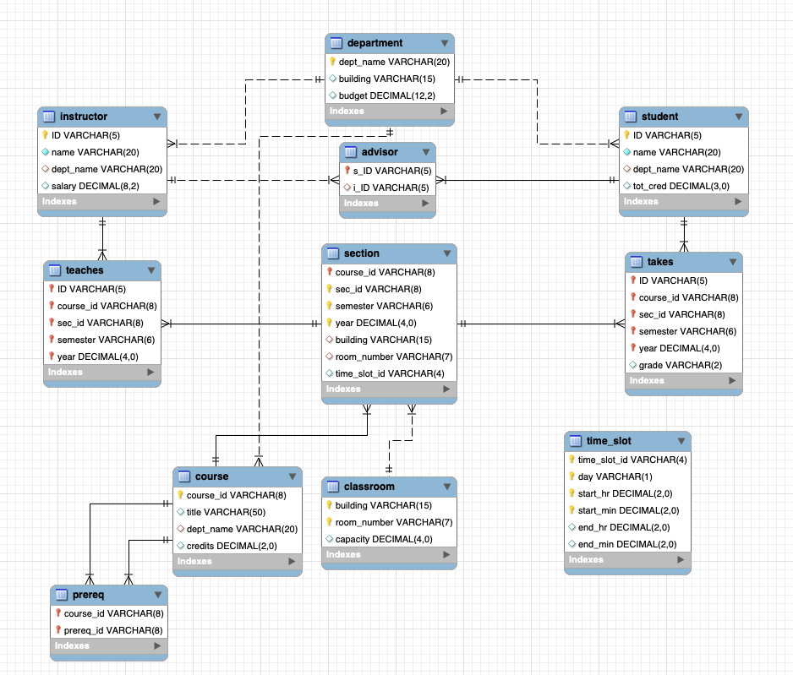
EER Diagram (for your project)
Create database using SQL queries
Database -> Reverse Engineer

